Slide 1

Amazon virtual private cloud (VPC) Topic: 3 Create by: Team 1 Date: 22/5/2019

Slide 2
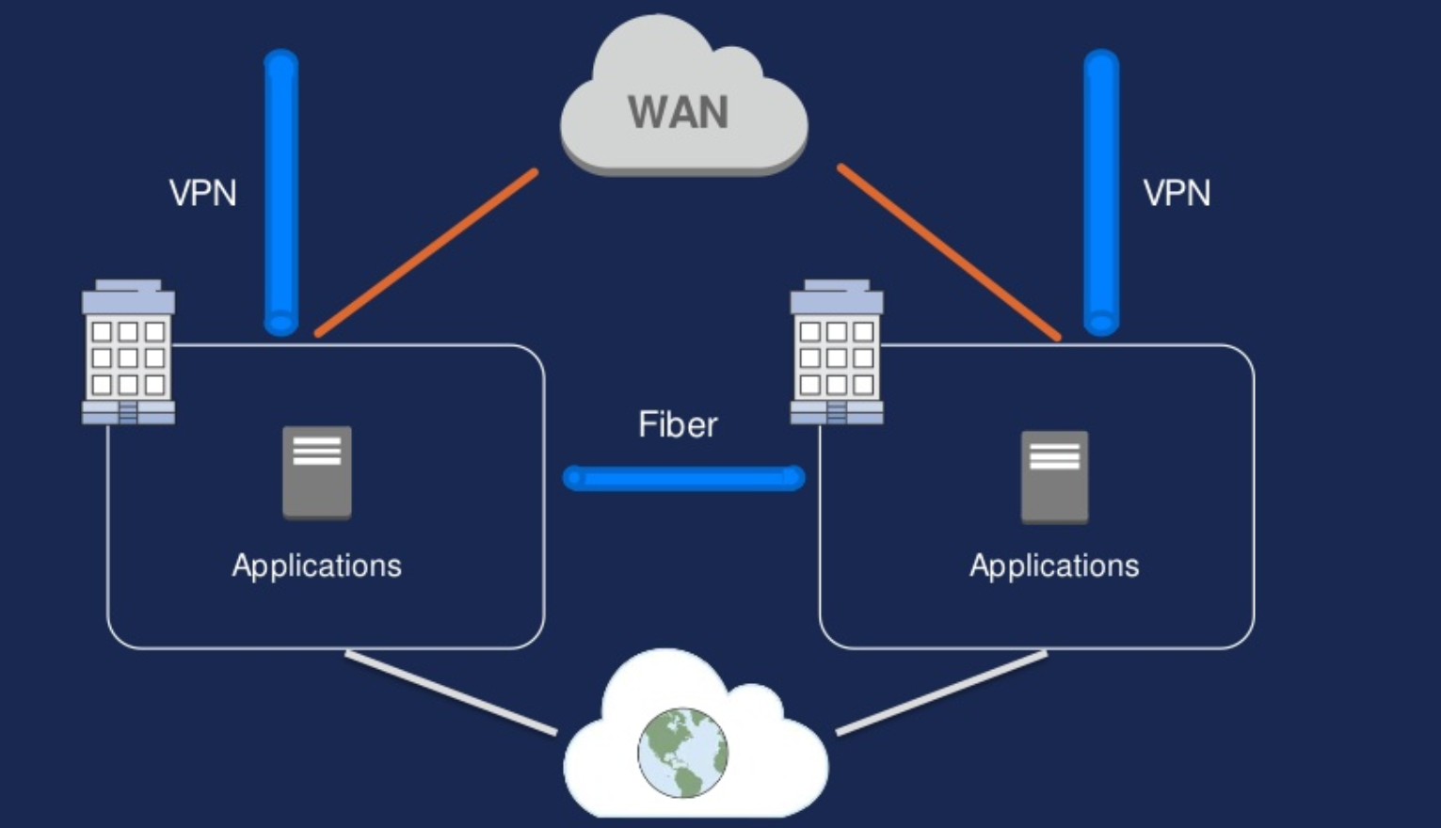
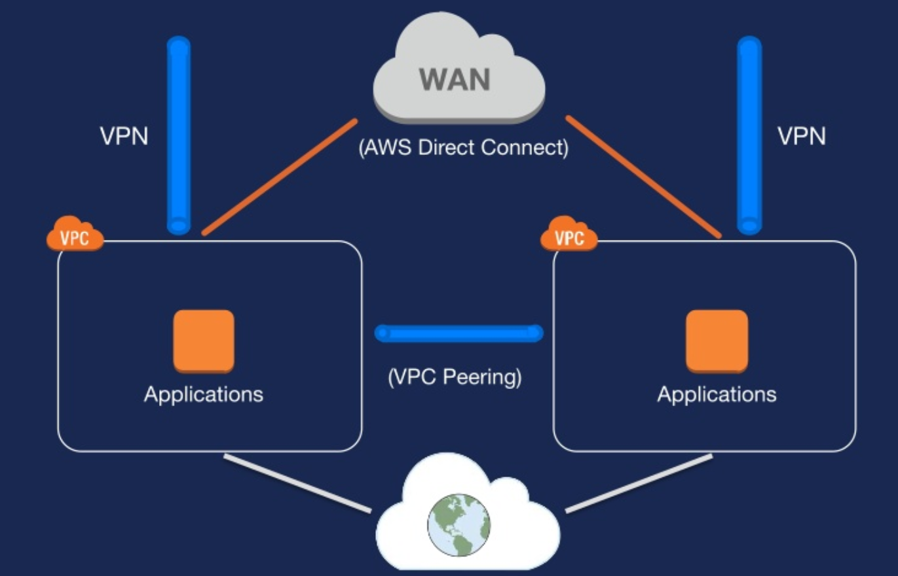
INTRODUCTION
Traditional network
AWS network

Slide 3
This topic will cover to:
Fundamentals:
VPC Overview
Picking you IP space
Subnet design
Routing and NATing
VPC Security
Advanced topic:
VPC Peering
VPC Flow Logging
VPC Endpoints
DC Connectivity:
IPsec VPN Tunnel
AWS Direct Connect

Slide 4
AWS VPC Overview

Slide 5

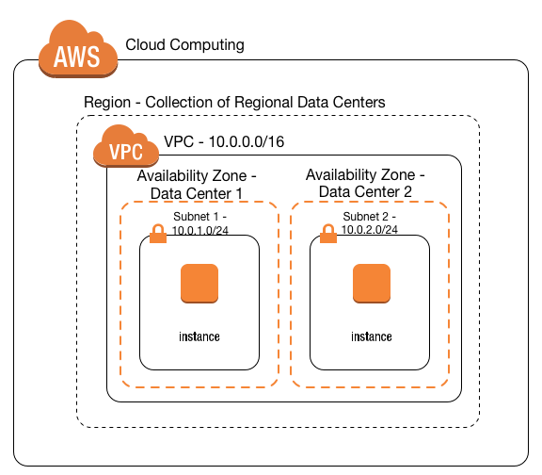
What is an Amazon Virtual private cloud (VPC)?
“A virtual network that closely resembles a traditional network that you’d operate in your own data center”

Slide 6
What’s in the VPC tool box?
VPC: User defined address space up to /16 (65,536 addresses)
Subnets: 200 user-defined subnets to /16
Route Tables: Define how traffic should be routed from/to each subnet
Access Control Lists: Stateless network filtering between subnets.
Internet Gateway: A logical device enabling traffic to be route to/from the public internet.
Managed NAT: Provide Network Address Translation to private instances for 10Gbps traffic.
Virtual Private Gateway: the Amazon end of a VPN connection.
Customer Gateway: The router at the customer end of a VPN connection.

Slide 7
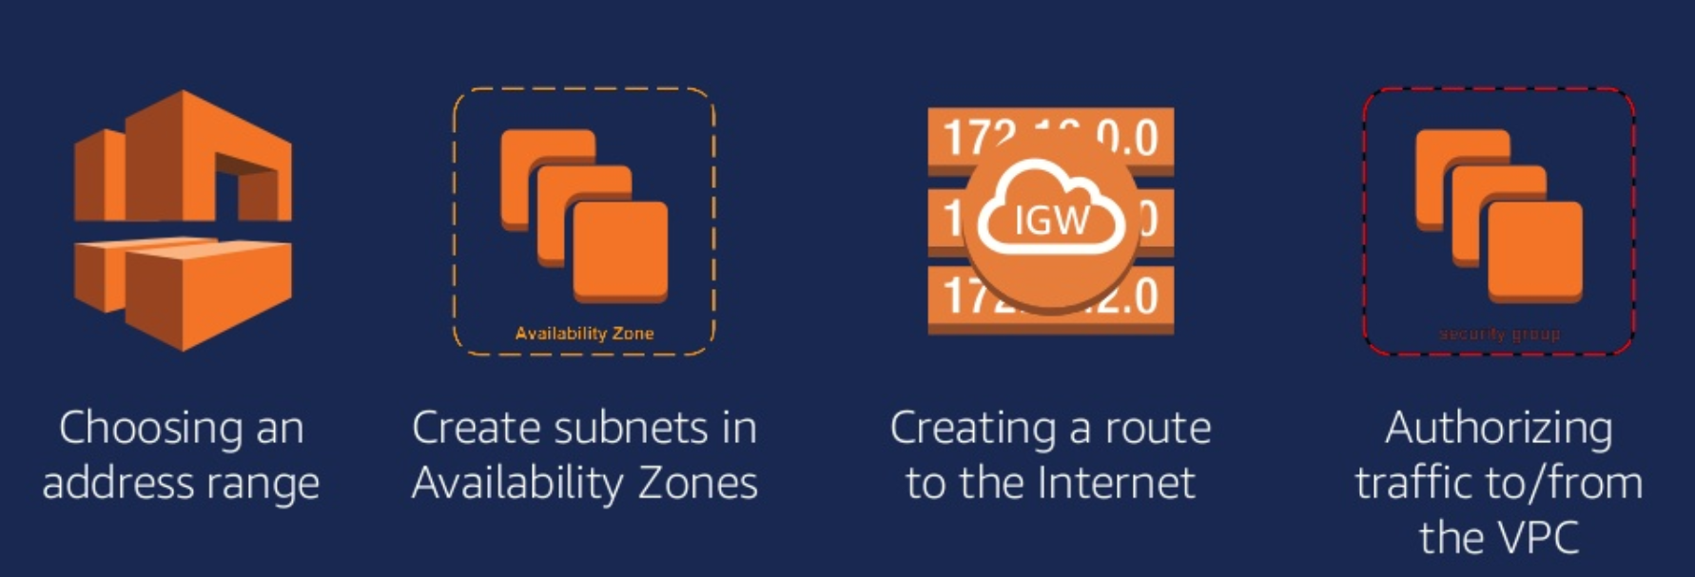
How to create an Internet-connected VPC?

Slide 8
IN TWO OR THREE COLUMNS
Yellow
Is the color of gold, butter and ripe lemons. In the spectrum of visible light, yellow is found between green and orange.
Blue
Is the colour of the clear sky and the deep sea. It is located between violet and green on the optical spectrum.
Red
Is the color of blood, and because of this it has historically been associated with sacrifice, danger and courage.

Slide 9
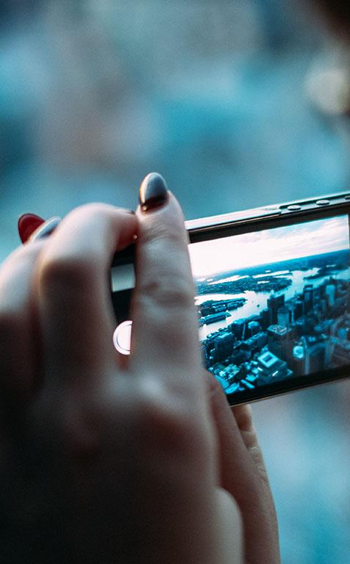
A PICTURE IS WORTH A THOUSAND WORDS
A complex idea can be conveyed with just a single still image, namely making it possible to absorb large amounts of data quickly.

Slide 10
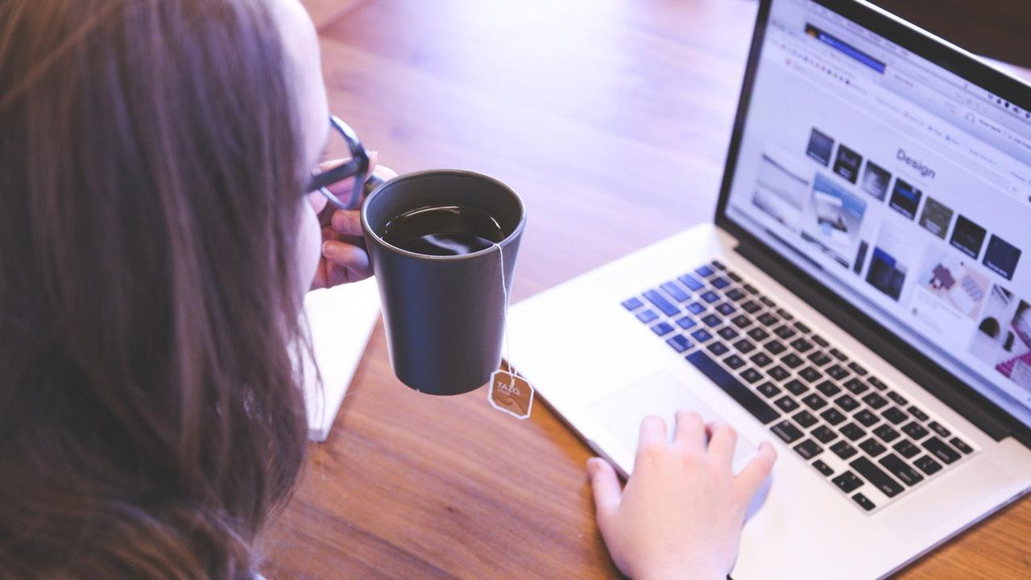
Want big impact?
Use big image.

Slide 11
USE CHARTS TO EXPLAIN YOUR IDEAS
White
Gray
Black

Slide 12
AND TABLES TO COMPARE DATA
 | A | B | C
Yellow | 10 | 20 | 7
Blue | 30 | 15 | 10
Orange | 5 | 24 | 16

Slide 13
MAPS
our office

Slide 14
89,526,124
Whoa! That’s a big number, aren’t you proud?

Slide 15
89,526,124$
185,244 users
100%
That’s a lot of money
And a lot of users
Total success!

Slide 16
OUR PROCESS IS EASY
first
second
last

Slide 17
LET’S REVIEW SOME CONCEPTS
Yellow
Is the color of gold, butter and ripe lemons. In the spectrum of visible light, yellow is found between green and orange.
Blue
Is the colour of the clear sky and the deep sea. It is located between violet and green on the optical spectrum.
Red
Is the color of blood, and because of this it has historically been associated with sacrifice, danger and courage.
Yellow
Is the color of gold, butter and ripe lemons. In the spectrum of visible light, yellow is found between green and orange.
Blue
Is the colour of the clear sky and the deep sea. It is located between violet and green on the optical spectrum.
Red
Is the color of blood, and because of this it has historically been associated with sacrifice, danger and courage.

Slide 18
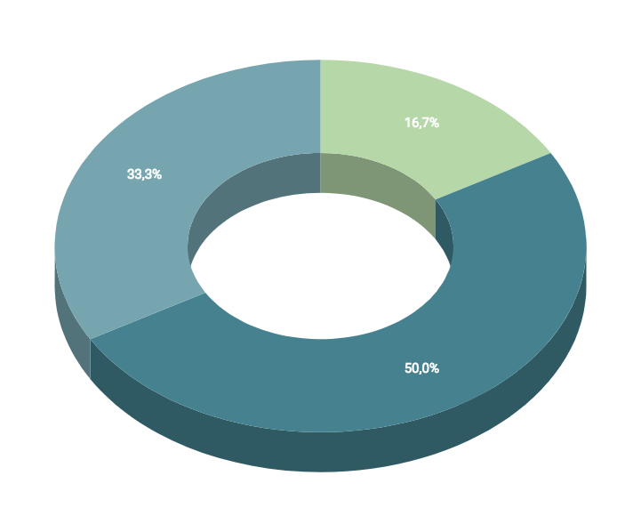
You can insert graphs from Google Sheets

Slide 19
ANDROID PROJECT
Show and explain your web, app or software projects using these gadget templates.
Place your screenshot here

Slide 20
iPHONE PROJECT
Show and explain your web, app or software projects using these gadget templates.
Place your screenshot here

Slide 21
TABLET PROJECT
Show and explain your web, app or software projects using these gadget templates.
Place your screenshot here

Slide 22
DESKTOP PROJECT
Show and explain your web, app or software projects using these gadget templates.
Place your screenshot here

Slide 23
THANKS!
Any questions?
You can find me at:
@username
user@mail.me

Slide 24
CREDITS
Special thanks to all the people who made and released these awesome resources for free:
Presentation template by SlidesCarnival
Photographs by Unsplash

Slide 25
PRESENTATION DESIGN
This presentation uses the following typographies and colors:
Titles: Dosis
Body copy: Titillium Web
You can download the fonts on these pages:
http://www.impallari.com/dosis
http://www.campivisivi.net/titillium/
Pastel green #d3ebd5 · Green #80bfb7 · Teal #0b87a1 · Navy #01597f · Dark navy #003b55
You don’t need to keep this slide in your presentation. It’s only here to serve you as a design guide if you need to create new slides or download the fonts to edit the presentation in PowerPoint®

Slide 26
SlidesCarnival icons are editable shapes.
This means that you can:
Resize them without losing quality.
Change fill color and opacity.
Change line color, width and style.
Isn’t that nice? :)
Examples:

Slide 27
😉
Now you can use any emoji as an icon!
And of course it resizes without losing quality and you can change the color.
How? Follow Google instructions https://twitter.com/googledocs/status/730087240156643328
✋👆👉👍👤👦👧👨👩👪💃🏃💑❤😂😉😋😒😭👶😸🐟🍒🍔💣📌📖🔨🎃🎈🎨🏈🏰🌏🔌🔑 and many more...

